Slide 1

在线社交网络中的用户隐私分析
User Privacy Analysis in Online Social Networks
曹玖新 教授
东南大学计算机科学与工程学院

Slide 2

概要
01
社交网络简介
OUTLINE
Introduction to Social Networks
02
社交网络与用户隐私泄露
Social Networks and User Privacy Leakage
03
社交网络的位置隐私保护
Location Privacy Protection in Social Networks
04
总结
Conclusion

Slide 3







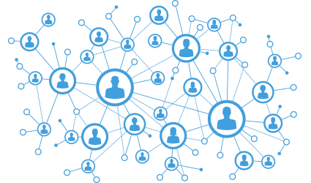





社交网络
Definition
Examples
Research
01
Social Network
SHARE
(Individuals or Organization)
Social Actors
Activity, Hobby,
Status, Ties
INFORMATION
ONLINE
Social Ties or Interactions
between Actors
Social Structure
3

Slide 4




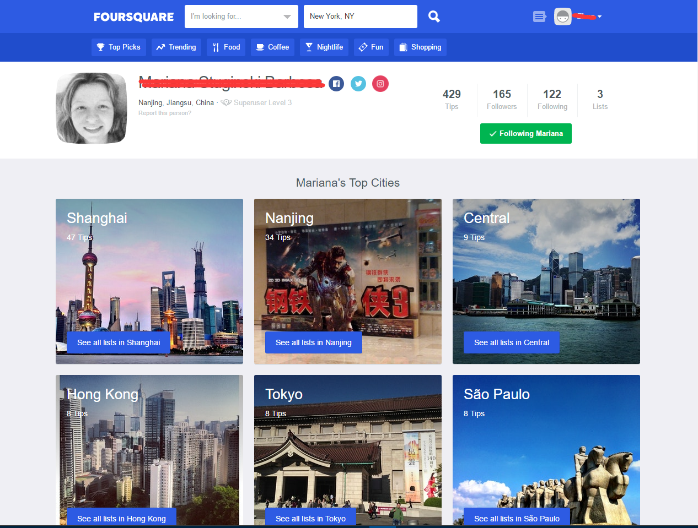
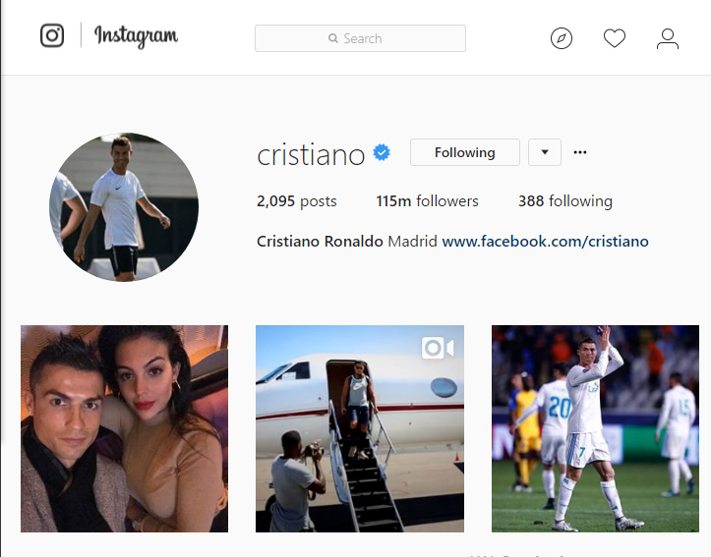
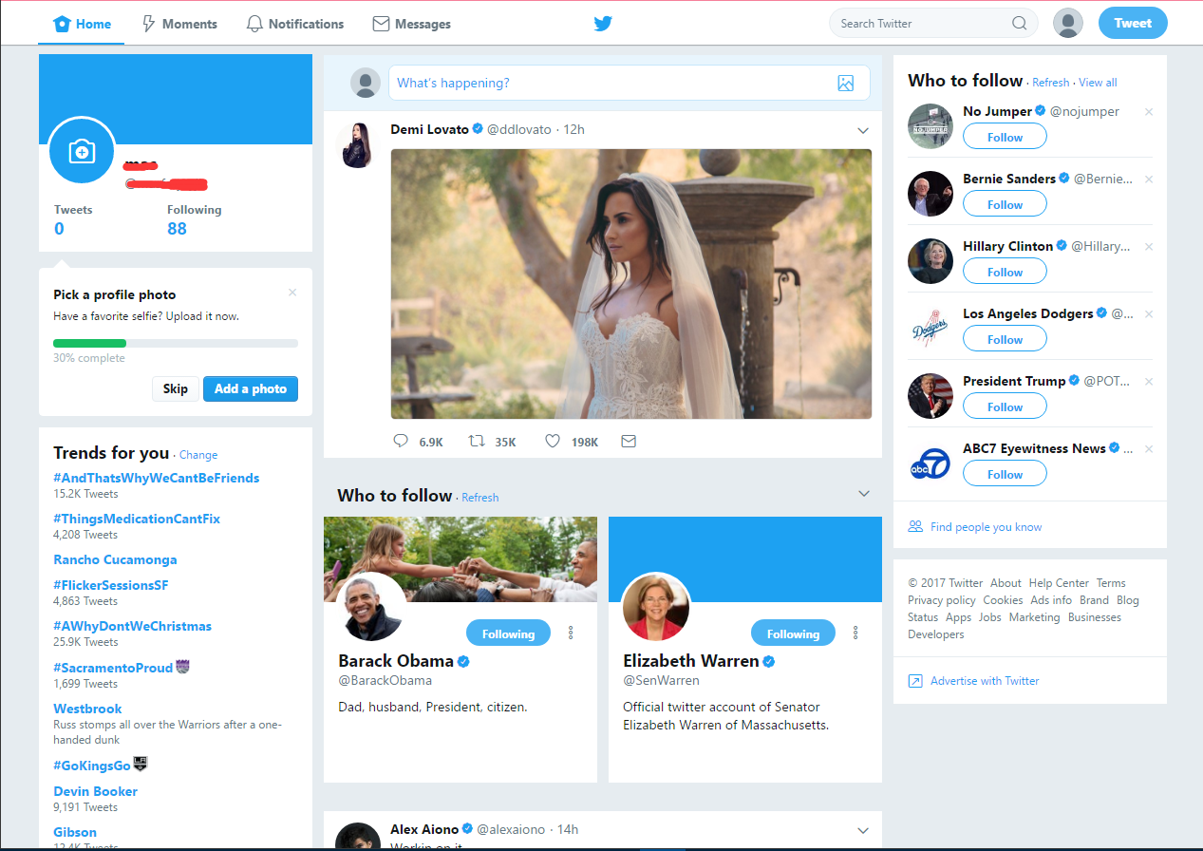
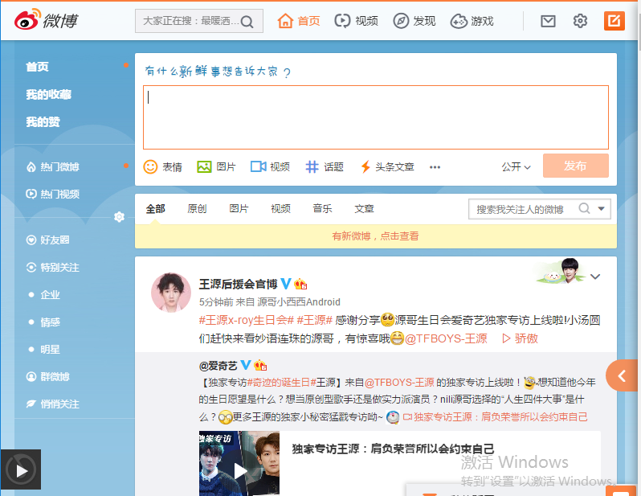


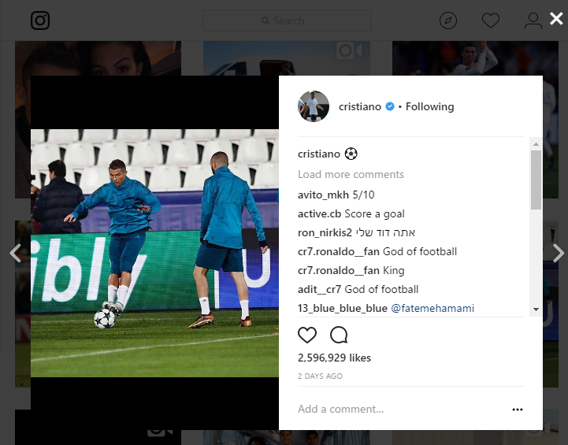


Examples
Foursquare
Monthly Active Users:
55 Million
Total Check-ins:
7 Billion
Total Tips:
75 Million
Total Venues:
65 Million
Most Check-ins in One Day:
7 Million
2015 via expandedramblings.com
Statistics in Typical Social Networks
Twitter
Registered Users:
645 Million +
New Users Every Day:
135,000
Monthly Active Users:
115 Million
Average Tweets Per Day:
58 Million
Tweets Every Second:
9,100
25/09/2015 via Statistic Brain
Instagram
Monthly Actives:
400 Million +
Photos Shared:
40 Billion +
Likes Daily:
3.5 Billion
Average Photos Per Day:
80 Million +
2016 via Instagram website
Sina Weibo
Monthly Active Users:
222 Million
Daily Active Users:
100 Million
9/2015 via sina report
Messages Posted Each Day:
100 Million (in 2012)
2/2012 via sina report
Multiple types of OSNs:
Twitter, Weibo…
Foursquare, Yelp…
Instagram, Flickr…
Quora, Zhihu…
Meetup…

Slide 5










Search
Research Platform
Social Network
(content)
Location Based Social Network
Event Base
Social Network
Image Related Social Network
Twitter
Foursquare
Meetup
Instagram
Sina Weibo
Yelp

Slide 6




Search
What we can do in social network with Data Analysis
– Examples
Understand Social Network
Understand User
Understand Information
Provide Service
e.g.
Topology properties
Network evolution
…
e.g.
Discover behavior pattern
Predict user behavior
Detect community
…
e.g.
Detect topic
Discover influential user
Predict information diffusion
…
e.g.
Recommendation
Privacy protection
…

Slide 7
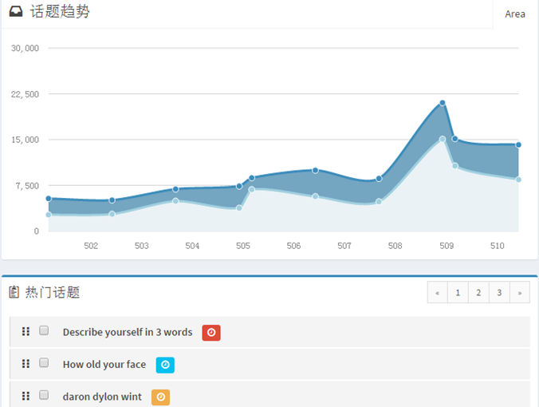
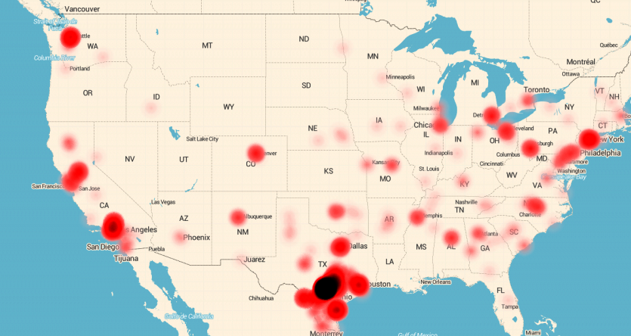
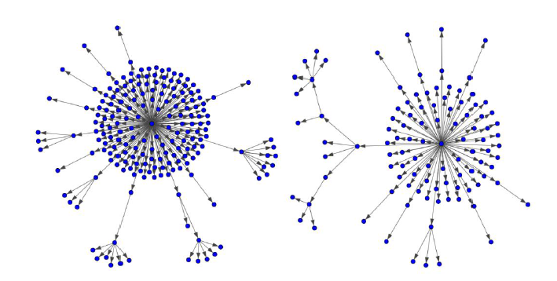
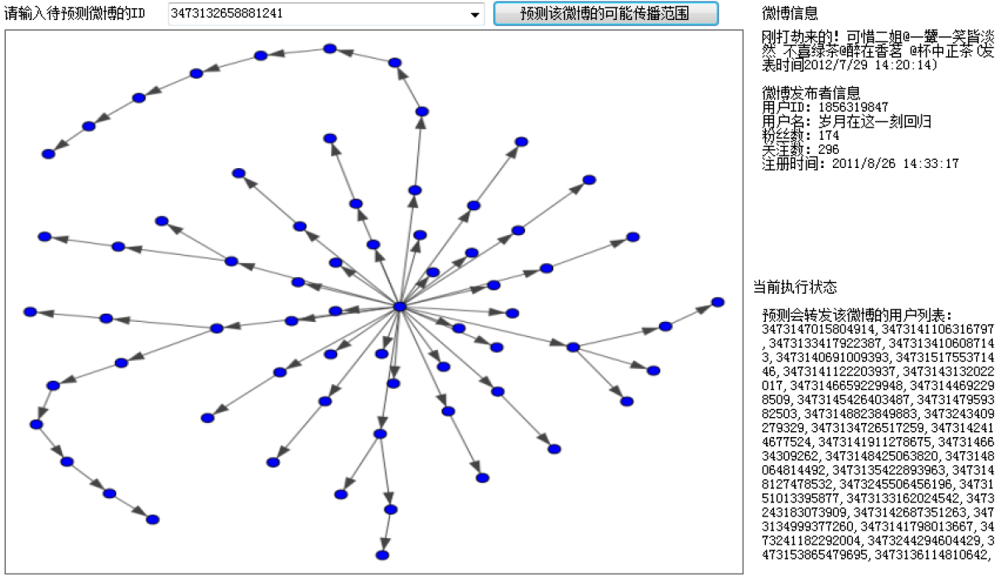
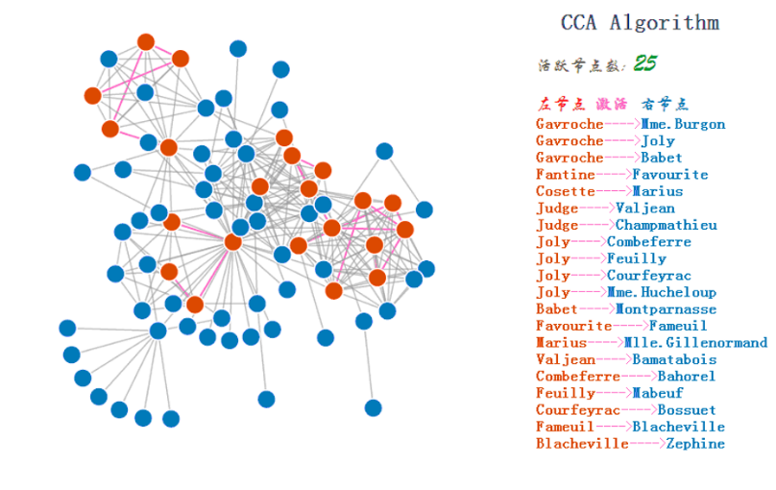

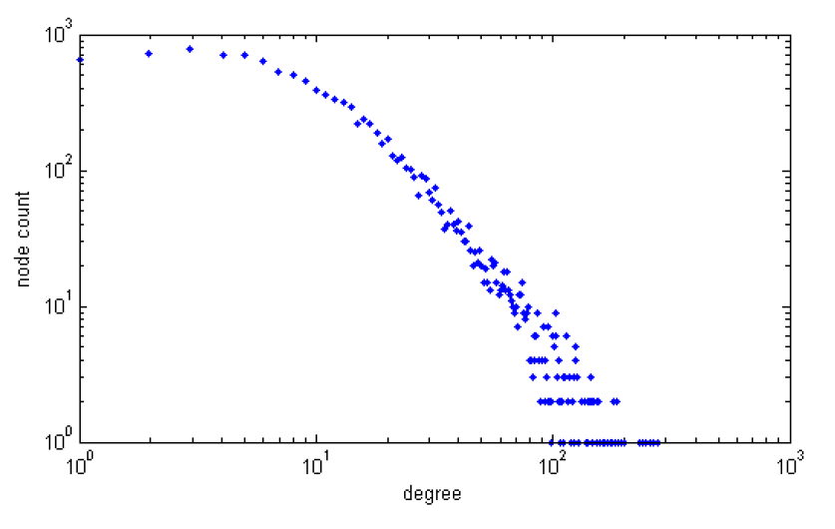
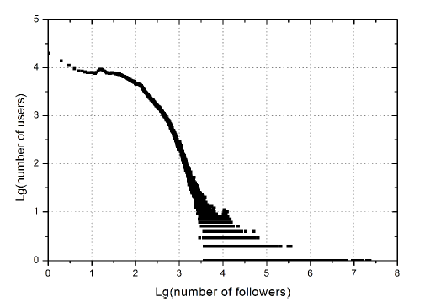

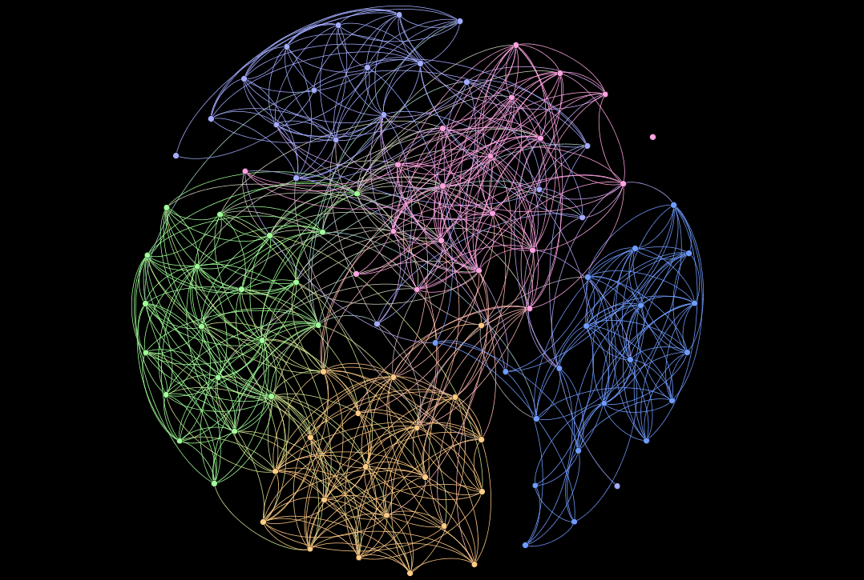
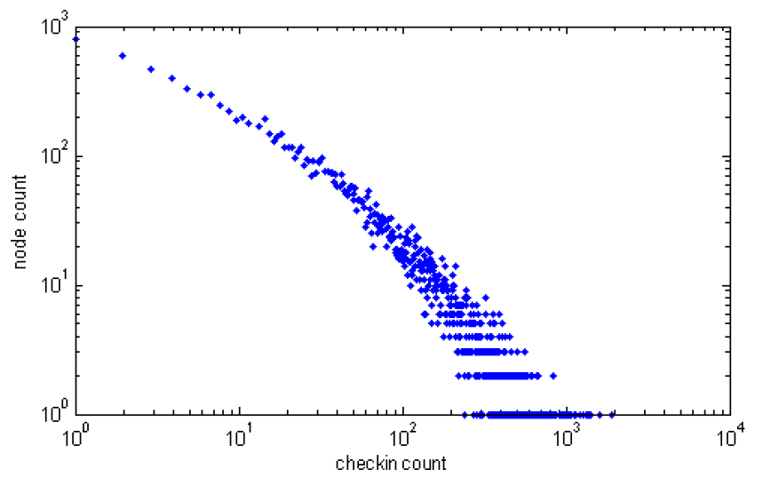
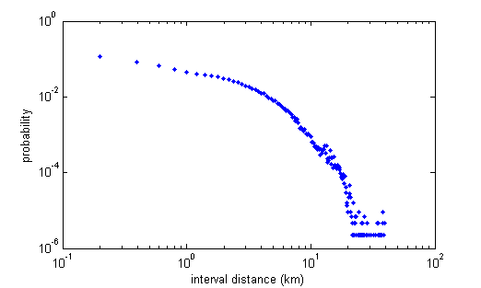
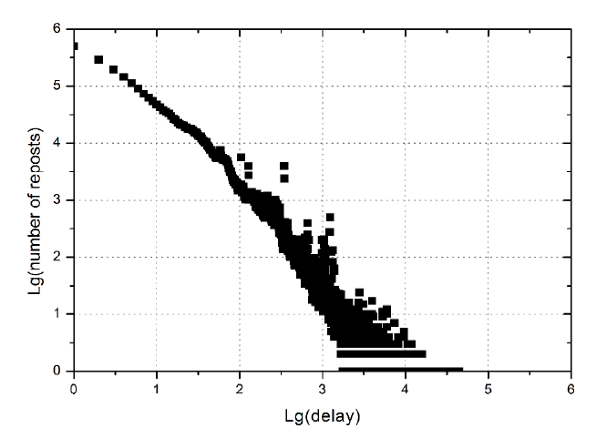
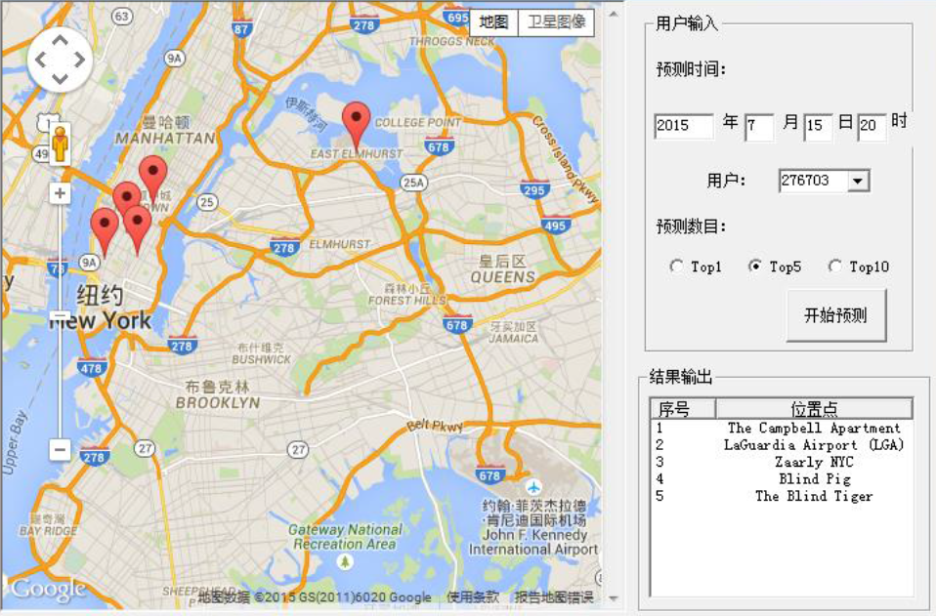
Geographic Distribution of Topic
Reposting Tree Topology
Topic Trend
Reposting Path Prediction
Influence Diffusion Simulation
Search
What we can do in social network with Data Analysis
– Examples
Understand Social Network
Understand User
Understand Information
Provide Service
Degree Distribution (Foursquare)
Degree Distribution (Sina Weibo)
Understand information in social network
Detect topic
Discover influential user
Predict information diffusion
…
Provide service for users
Recommendation
Privacy pretection
…
User Community
User check-in count distribution (Foursquare)
User Displacement Distribution (Foursquare)
Number of check-ins/users in a week(Foursquare)
Distribution of reposting delay (Sina Weibo)
Check-in behavior prediction (Foursquare)
Notes:
接下来我们看几个例子，更详细地感受一下数据分析的作用，首先在……方面……

Slide 8
社交网络与用户隐私泄露
Introduction
Our Research
02
Social Network and User Privacy Leakage
status, ties, activity, hobby
share, like, comment,
retweet, local search, …
Behavior
Information
content-based
ties-based
Understand User
Leakage
Provide Service
self-image-based
Profile
Ties
sex, city, age,
profession, …
follower, friends,
group, community, …

Slide 9
Our Researches Related with Privacy Leakage
Community Discovery in Social Network
User Privacy Leakage in Joint Preference
Multi-dimensional community discovery in LBSN
consider social relations and temporal-spatial topics
Different community discovery method for multiple purposes
topic community ; property based community…
Users are clustered according to different properties.
Behavior Analysis and Prediction
User Privacy Leakage in Future Location
Check-in behavior prediction
with or without given time
User location recommendation
Opinion Detection and Social Trend Sensing

Slide 10
Our Researches Related with Privacy Leakage
2.1
User Privacy Leakage in Joint Preference
Traditional Problem
Topic Based
Temporal-spatial Topic Based
2.2
User Privacy Leakage in Location

Slide 11
2.1.1
User Privacy Leakage in Joint Preference—Community Detection
Community
No precise definition of what a ''community'' is is universally accepted.The most widely used definition is given by Newman and Gievan (2004):
A gragh has a community structure if the number of links into any subgragh is higher than the number of links between those subgraghs. Or there must be more edges ''inside'' the community than edges linking vertices of the community with the rest of the graph.
We have studied
Traditional Problem
Topic Based
Temporal-spatial Topic Based

Slide 12
2.1.1
User Privacy Leakage in Joint Preference—Community Detection
Community Detection Methods
To describe how users are clustered in a group in a social network
Agglomerative Method（凝聚方法）
Divisive Method（划分方法）
…

Slide 13

Our Researches Related with Privacy Leakage
2.1
User Privacy Leakage in Joint Preference
Traditional Problem
Topic Based
Temporal-spatial Topic Based
2.2
User Privacy Leakage in Location

Slide 14
2.1.2
User Privacy Leakage in Joint Preference—Community Detection
General Framework
Topic Identification
Topic Community
Social network datasets including
user relations, tweets and comments

Slide 15
2.1.2
User Privacy Leakage in Joint Preference—Community Detection
Start
Topic Identification
Topic Community
Preprocess the text
NO
Social network datasets including
user relations, tweets and comments
Obtain the text vector
Compute the similarity with existing topics, record the greatest similarity and corresponding topic
Topic Identification
Process complete?
Topic Community
Social network datasets including
user relations, tweets and comments
Similarity larger than threshold?
YES
NO
YES
Define a new topic
Update the topic set
Finish

Slide 16
2.1.2
User Privacy Leakage in Joint Preference—Community Detection
Topic Identification
Topic Community
Social network datasets including
user relations, tweets and comments
Topic Community Construction
Layer A: Original network
Layer B:
users who posted about the same topic t_{i} are put into user set U
Layer C:
for users in set U, extract user interactions from original dataset and add edges
obtain the topic community

Slide 17
Our Researches Related with Privacy Leakage
2.1
User Privacy Leakage in Joint Preference
Traditional Problem
Topic Based
Temporal-spatial Topic Based
2.2
User Privacy Leakage in Location

Slide 18
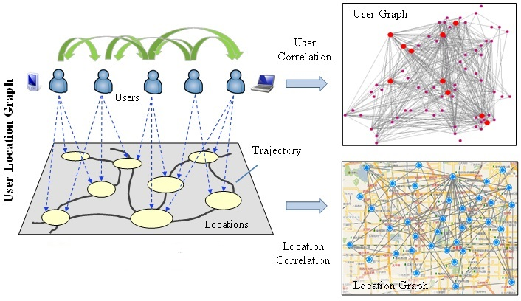
2.1.3
User Privacy Leakage in Joint Preference—Community Detection
Location Based Social Network (LBSN)
Community
Temporal
Spatial
Topic

Slide 19
2.1.3
User Privacy Leakage in Joint Preference—Community Detection
Temporal
Spatial
Distribution of check-in and active user under week mode
Distribution of distance

Slide 20
Tag clouds of two Foursquare users from New York
city. Larger font size implies higher frequency, and vice
versa.
2.1.3
User Privacy Leakage in Joint Preference—Community Detection
Topic
User A
User B
Tag clouds of two Foursquare users from New York city. Larger font size implies higher frequency, and vice versa

Slide 21
2.1.3
User Privacy Leakage in Joint Preference—Community Detection
Discovery Model--Graphical Representation
T
Ni
f
好友
社区
用户
第一类签到
第二类签到
兴趣
兴趣
地域
地域
位置
位置

Slide 22
Check-in heatmap of communities. Darker colors
represent more check-ins.
2.1.3
User Privacy Leakage in Joint Preference—Community Detection
Experimental Results
Community corresponding to nightlife
Community corresponding to profession
Check-in heatmap of communities. Darker colors represent more check-ins.

Slide 23
Check-in heatmap of communities. Darker colors
represent more check-ins.
2.1.3
User Privacy Leakage in Joint Preference—Community Detection
Experimental Results
Perplexity comparison result
Modularity comparison result
From the graph, we can get that our methods can detect users with same preference at

Slide 24
Our Researches Related with Privacy Leakage
2.1
User Privacy Leakage in Joint Preference
2.2
User Privacy Leakage in Location

Slide 25
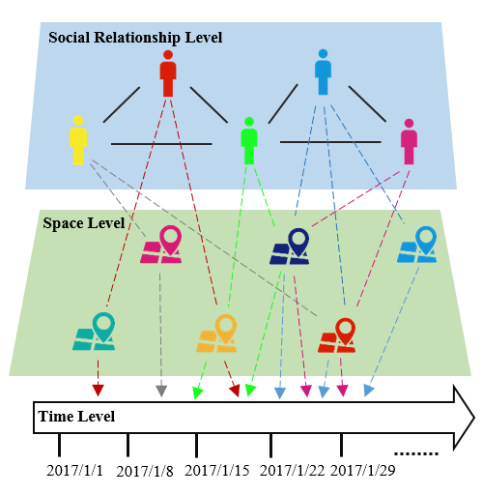
2.2
User Privacy Leakage in Future Location—Location Prediction
Location Based Social Network (LBSN)
To predict the check-in location for a user u at any future time t
Scoring model definition:
Given：
(a) A user u_{i}’s check-in records with L_{i} distinct locations
(b) A specific time t accurate to hour
The model is to rank all the L_{i} locations so that the exact location u_{i} will visit at time t is ranked at the highest possible position in the ranking list.

Slide 26
2.2
User Privacy Leakage in Future Location—Location Prediction
Scoring Model

Slide 27
2.2
User Privacy Leakage in Future Location—Location Prediction
Basic steps of scoring model based location prediction:
Feature extraction (12 features including time periodicity, global popularity and personal preference)
Feature combination using a weighted sum approach
Candidate locations ranking according to scores
Top-N location prediction

Slide 28
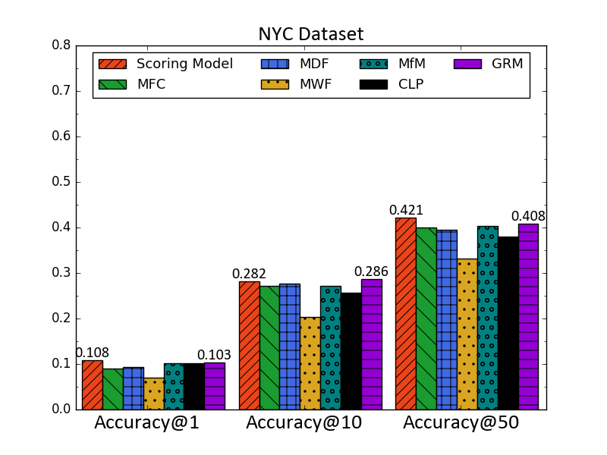
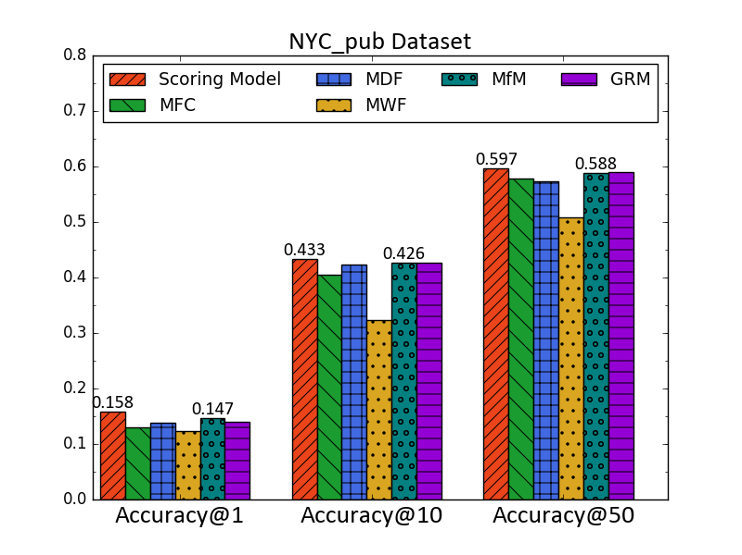
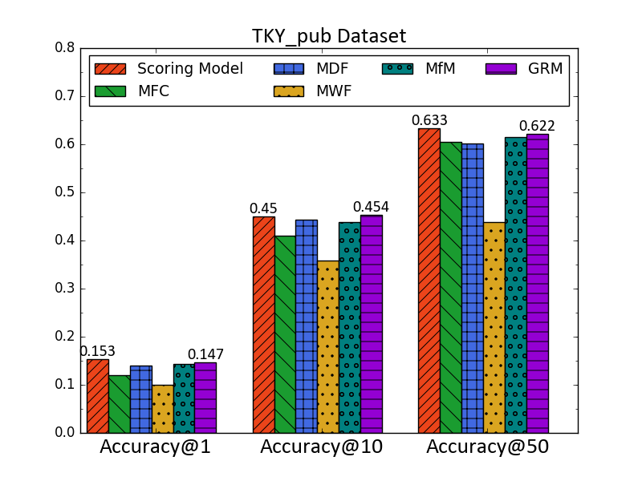
2.2
User Privacy Leakage in Future Location—Location Prediction
Experimental Results
mean Accuracy@N results.
According the graph, in NYC, NYC_pub and TKY_pub datasets, each method‘s accuracy increase over the prediction list size. and our scoring model always maintains the best accuracy compared to other model.

Slide 29
2.2
User Privacy Leakage in Future Location—Location Prediction
Location Based Social Network (LBSN)
To predict the check-in location for a user u at any future time t
Classification model definition:
Given：
(a) A user u_{i}’s check-in records with L_{i} distinct locations
(b) A specific time t accurate to hour
(c) A candidate location v_{j}
The model is to classify whether u_{i} will check-in at v_{j} at time t.

Slide 30
2.2
User Privacy Leakage in Future Location—Location Prediction
Classification Model

Slide 31
2.2
User Privacy Leakage in Future Location—Location Prediction
Basic steps of classification model based location prediction:
Feature extraction (12 features including time periodicity, global popularity and personal preference)
Feature combination using a decision-tree model (Training)
Label Generation on whether a given location will be visited (Testing)

Slide 32
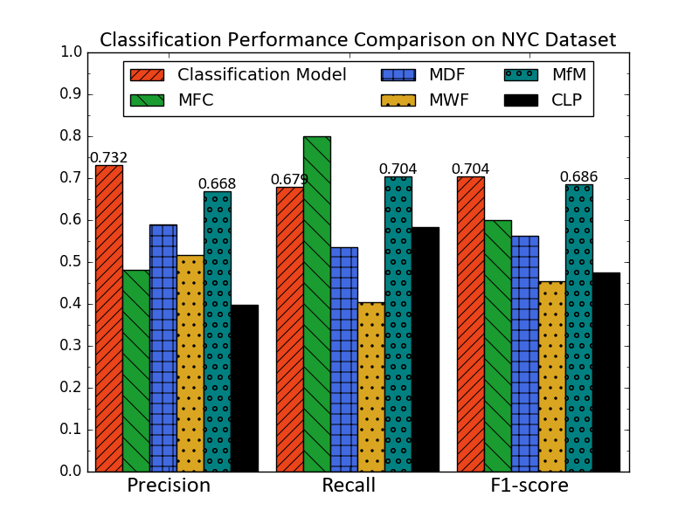
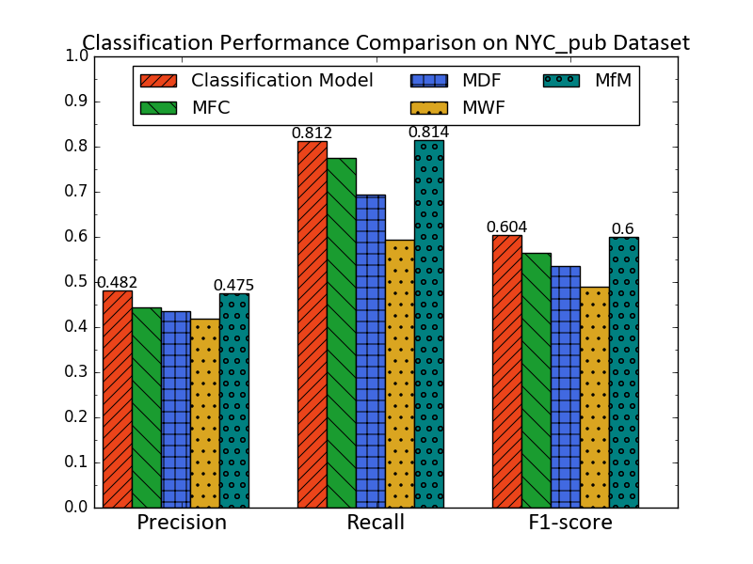
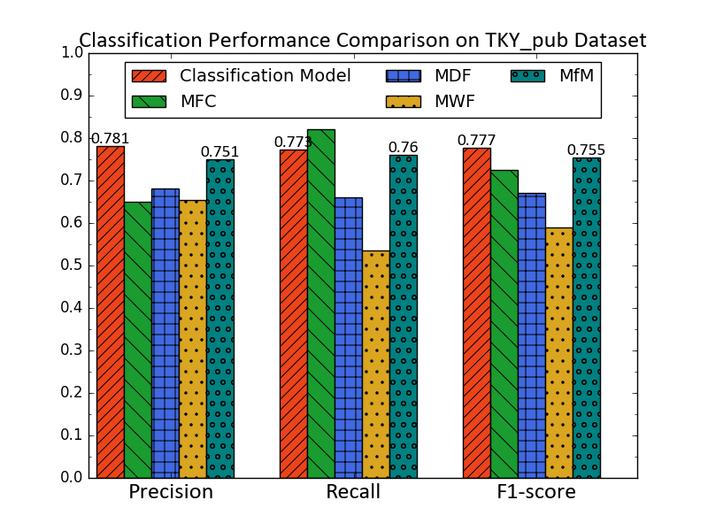
2.2
User Privacy Leakage in Future Location—Location Prediction
Experimental Results
The prediction performance of the classification model and baseline methods.
From the graph, we can get that our classification model can’t maintains the best precision and recall compared to other methods, but the F1-score of our classification model is always highest in three datasets.

Slide 33






社交网络的位置隐私保护
Introduction
Our Research
03
Location Privacy Protection in Social Networks
Mix-zone
dummy
users
pseudo
location
pseudo
location
Mobile Phone
Provide LBS
(Location-based Service)
search-based LBS
share-based LBS
Smartphone
pseudo
location
Notes:
dummy user：用户经过mix-zone区域时会更换自己的身份标识，通过不断地更换保护用户的位置隐私
pseudo location：提交一个虚假的位置，最典型的是k匿名
same-origin attack: 同源攻击，一个用户在同一个地点多次提交查询请求（search-based LBS）
Attack from Anonymous Geographic Neighborhoods Discovery: wechat中摇一摇，附近的好友功能，如果已知好友的位置也会造成位置隐私的泄露（share-based LBS）

Slide 34
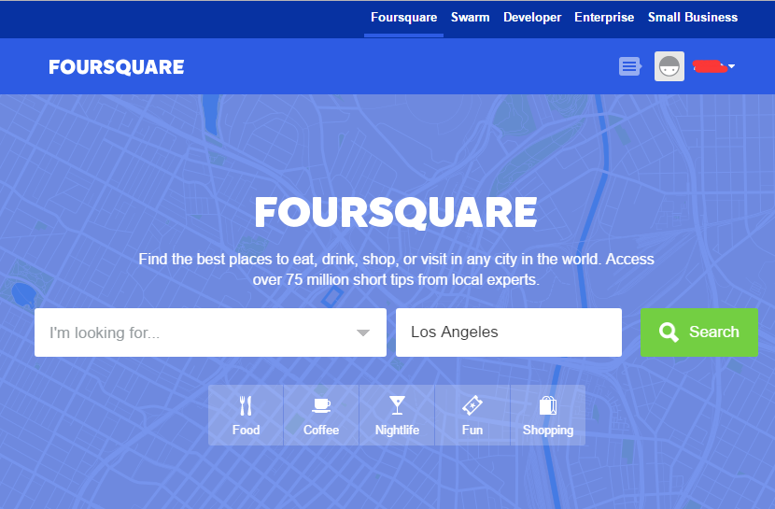














Our Researches Related with Location Privacy Protection
Background
User Account Linkage
User Account Linkage
Foursquare
Foursquare
Swarm
Swarm
local search
Check-in
local search
Check-in

Slide 35
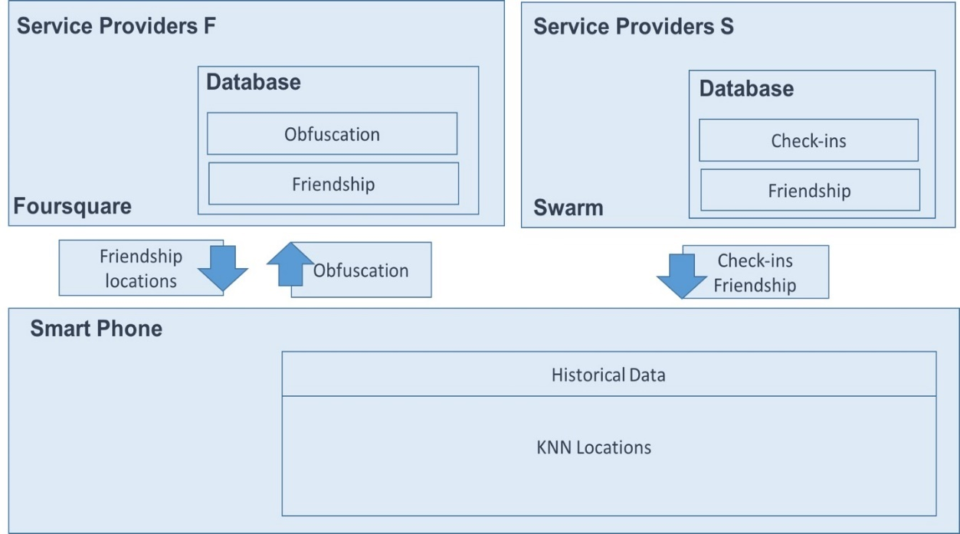
Our Researches Related with Location Privacy Protection
User Account Linkage
Protection Framework
User’s Trajectory
Information Integration
Friends’ Trajectory
Leakage of next location

Slide 36
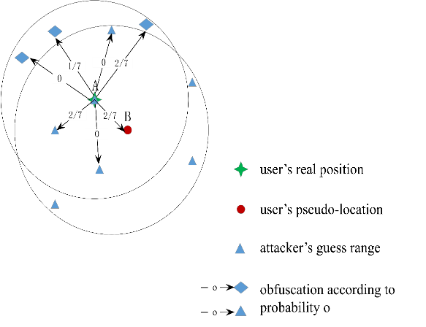

Our Researches Related with Location Privacy Protection
What we have done
Trajectory and Friendship based location privacy preserving
Basic Obfuscation
Location-based attack model
Mechanism 2
Non-cooperative game model
User Privacy Leakage in Location
Mechanism 1
Multi-objective optimization
Notes:
基本的模糊服从均匀分布或者贝叶斯分布
A先以图中概率模糊到7个周围的位置，假设最终选择了B，提交B为虚假位置，对于攻击者，只看到了B，然后进行猜测，所有标为三角形的位置（7个，其中有一个与A重叠，不容易看清楚）为猜测的位置。

Slide 37
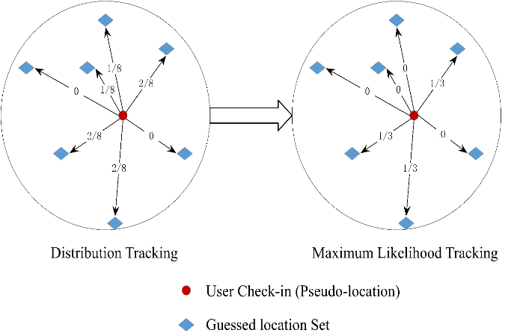
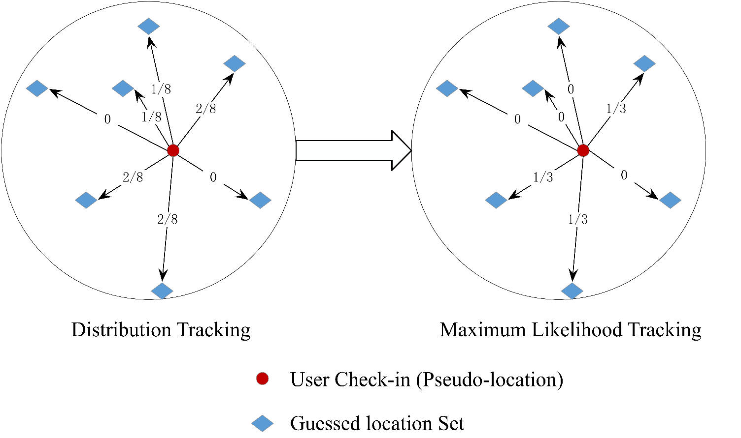
Our Researches Related with Location Privacy Protection
What we have done
Trajectory and Friendship based location privacy preserving
Basic Obfuscation
Location-based attack model
Mechanism 2
Non-cooperative game model
User Privacy Leakage in Location
Mechanism 1
Multi-objective optimization
Notes:
基本的模糊服从均匀分布或者贝叶斯分布
A先以图中概率模糊到7个周围的位置，假设最终选择了B，提交B为虚假位置，对于攻击者，只看到了B，然后进行猜测，所有标为三角形的位置（7个，其中有一个与A重叠，不容易看清楚）为猜测的位置。

Slide 38

04
总结
Conclusion
SHARE
(Individuals or Organization)
Social Actors
Activity, Hobby,
Status, Ties
INFORMATION LEAKAGE
ONLINE
Social Ties or Interactions
between Actors
Social Structure

Slide 39
04
总结
Conclusion
Activity, Hobby,
Status, Ties
INFORMATION LEAKAGE
Inference
Attacks
Protections

Slide 40




Dataset of Social Networks
Sina Weibo
Twitter
Users : 1,900,000
Relations : 137,000,000
Tweets : 10,700,000
Tweet in USA : 4,200,000
Tweet in NYC : 584,000
Tweet in SFO : 463,000
Foursquare
Users : 120,000
Relations : 3,700,000
Check-ins : 15,500,000
Preparing More…

Slide 41















